Slide 1
Remote Procedure Call

Slide 2
What is Remote Procedure Call?
RPC is an inter-process communication that allows a program to execute a procedure in another address space.
The client class the client stub as a local procedure call.
The client stub packs the parameters into a message (Marshalling) and sends it to the server machine.
The server stub unpacks the parameters (Unmarshalling) calls the server procedure.

Slide 3
What is Remote Procedure Call?
RPC hides communication details behind a procedure call and helps bridge heterogeneous platforms
Sockets are OS-level interfaces to the underlying communication protocols.
UDP transports data packets without guarantees.
TCP verifies correct delivery of data streams
Internet Protocol (IP) moves a packet of data from one node to another.

Slide 4
RPC Examples
Sun RPC, used in NFS filesystem.
CORBA, Microsoft DCOM
Java RMI, Microsoft .NET Remoting
Action Message Format (AMF) in Flex
XML-RPC, JSON-RPC, MsgPack-RPC
SOAP, REST
Facebook’s Thrift, Google Protocol Buffers, gRPC

Slide 5
Failures Handling in RPC
Lost packets, broken network, crashed servers
The client never sees a response from the server.
The client does not know if the server saw the request.

Slide 6
“At Least Once” Behavior
The client waits for response for a while
If none arrives, re-send the request.
Do this a few times and still no response.

Slide 7
“At Least Once” Behavior
Simple Problem:
The client sends put(a).
The server gets request, but network drops reply.
The client re-sends put(a).
Should the server respond “yes” or “no”?

Slide 8
“At Least Once” Behavior
Harder Problem:
Request 1: put(a), but network delays the packet.
Request 2: put(a), got the response
Now, should the server respond to request 1?

Slide 9
When “At Least Once” is OK?
Read-Only operations with no side effects.
If application has its own plan for detecting duplicates

Slide 10
“At Most Once” Behavior
Server detects duplicate requests and returns previous reply instead of re-running the request.
Client includes unique ID (UID) with each request and uses same UID for re-send.

Slide 11
“At Most Once” Complexities
How to ensure UID is unique?
Big random number?
Unique client ID (using IP address) with sequence #?
Per-client RPC sequence numbers.
Only allow client one outstanding RPC at a time arrival of sequence + 1
Client agrees to keep retrying for < 5 min and server discards after 5+ min.
How to handle duplicate requests while original is still processing?
“pending” flag per executing RPC; wait or ignore.

Slide 12
What if “At-most-once” server crashes?
If the duplicate detection logic stores in memory, server will forget and accept duplicate requests.
Should it write the duplicate info to disk?
Have replica servers to replicate duplicate info?

Slide 13
gRPC
Loosely coupled and multilingual development.
Synchronous, asynchronous, and streaming interfaces.
Transport over HTTP/2 + TLS
Why HTTP? Firewalls, load balancers, encryption, authentication, compression…
Treat RPC as references to HTTP object.
Encode request method name as URI
Encode request parameters as Body
Encode return value in HTTP response.
http://www.http2demo.io/

Slide 14
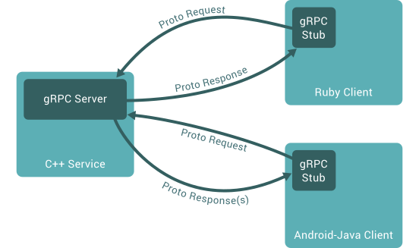
src: https://grpc.io/

Slide 15
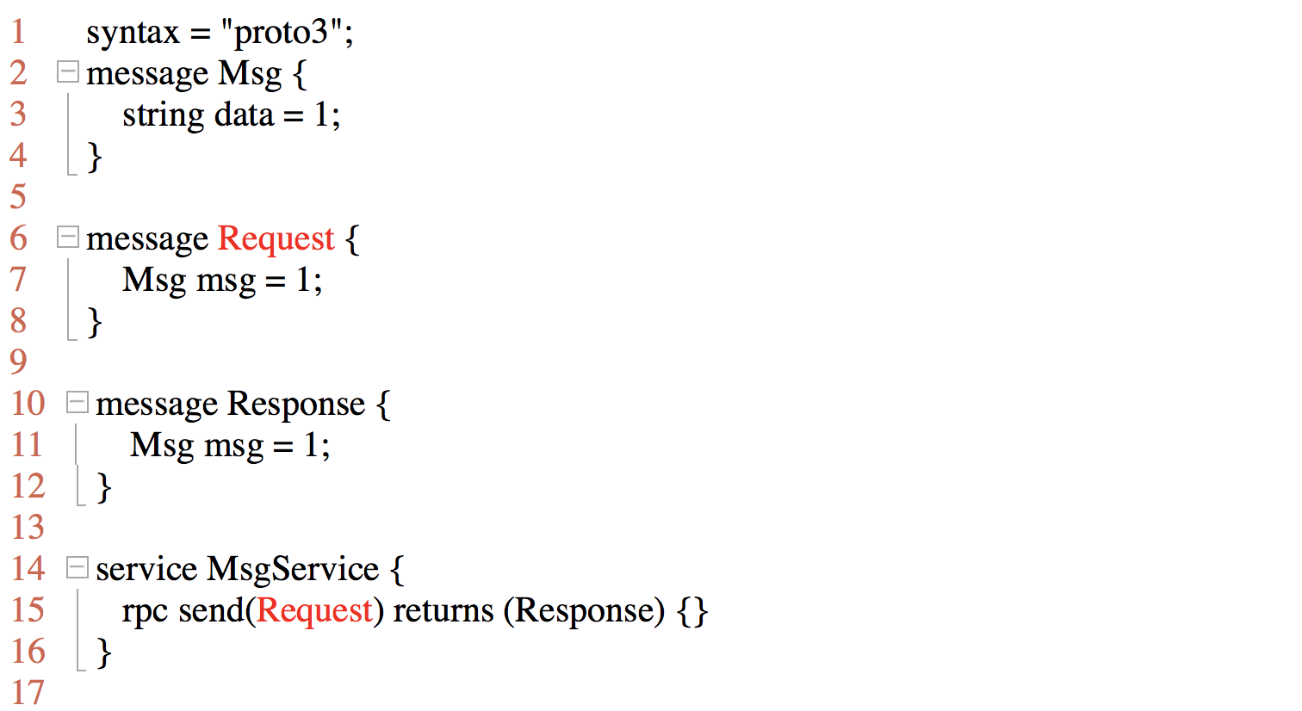
gRPC - IDL
IDL to describe service API

Slide 16
gRPC Request

Slide 17
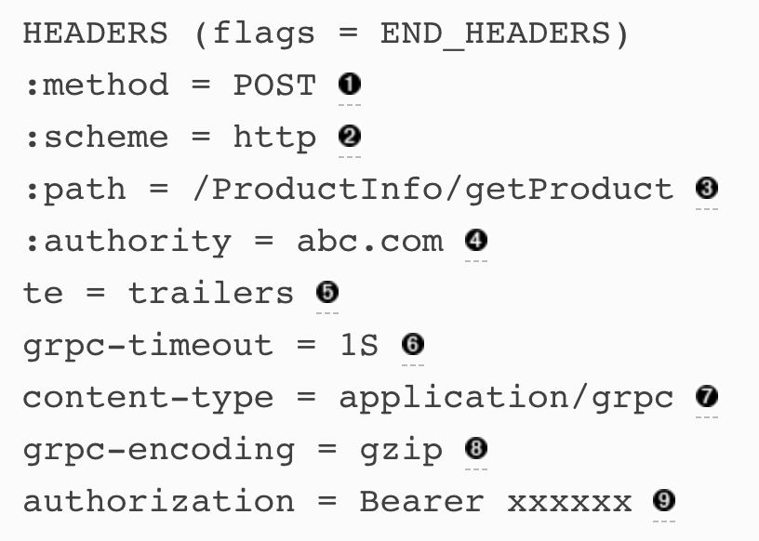
gRPC Request Header

Slide 18
gRPC Response

Slide 19
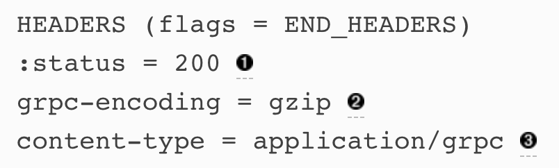
gRPC Response Header

Slide 20
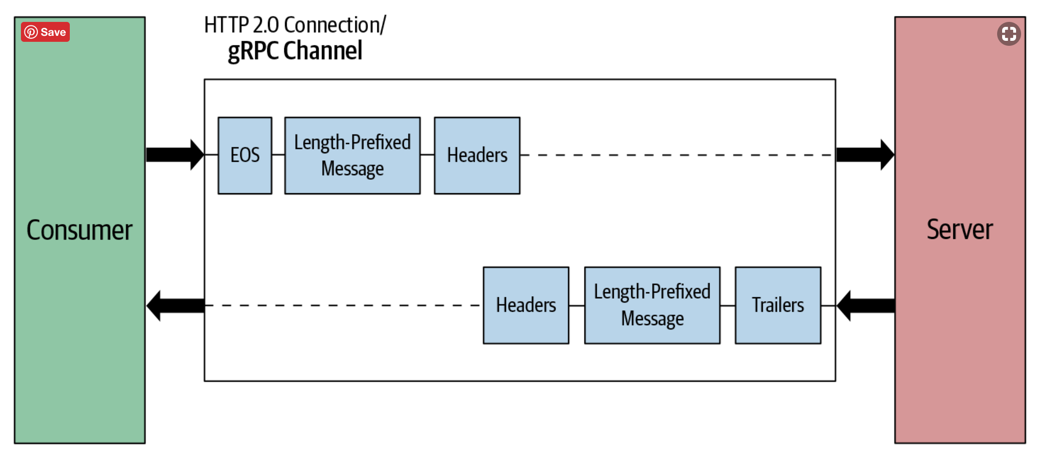
gRPC Request - Response

Slide 21
gRPC Communication Patterns
gRPC supports four fundamental communication patterns:
Unary RPC (Simple RPC)
Server-side streaming
Client-side streaming
Bidirectional streaming

Slide 22
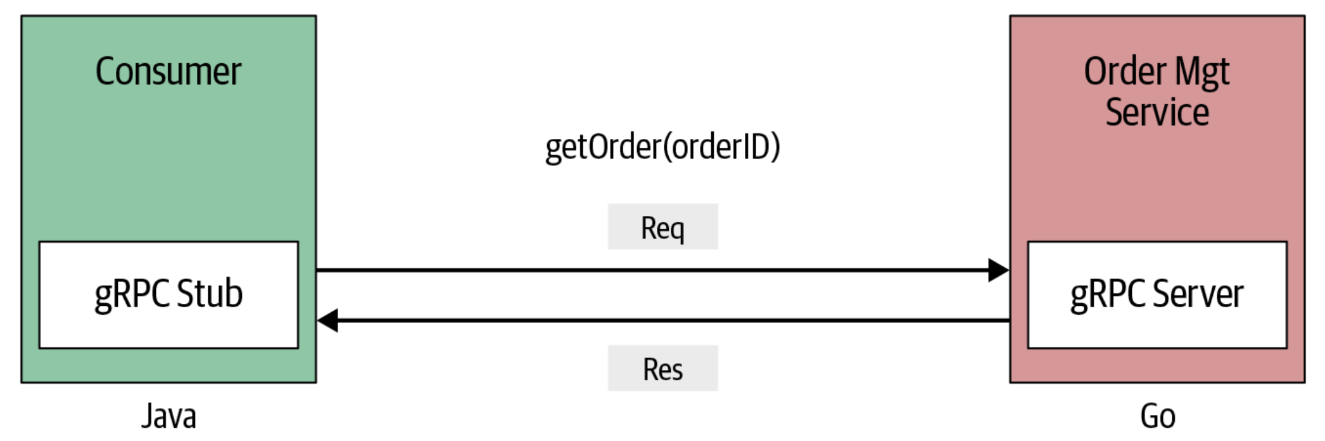
Unary RPC (Simple RPC)

Slide 23
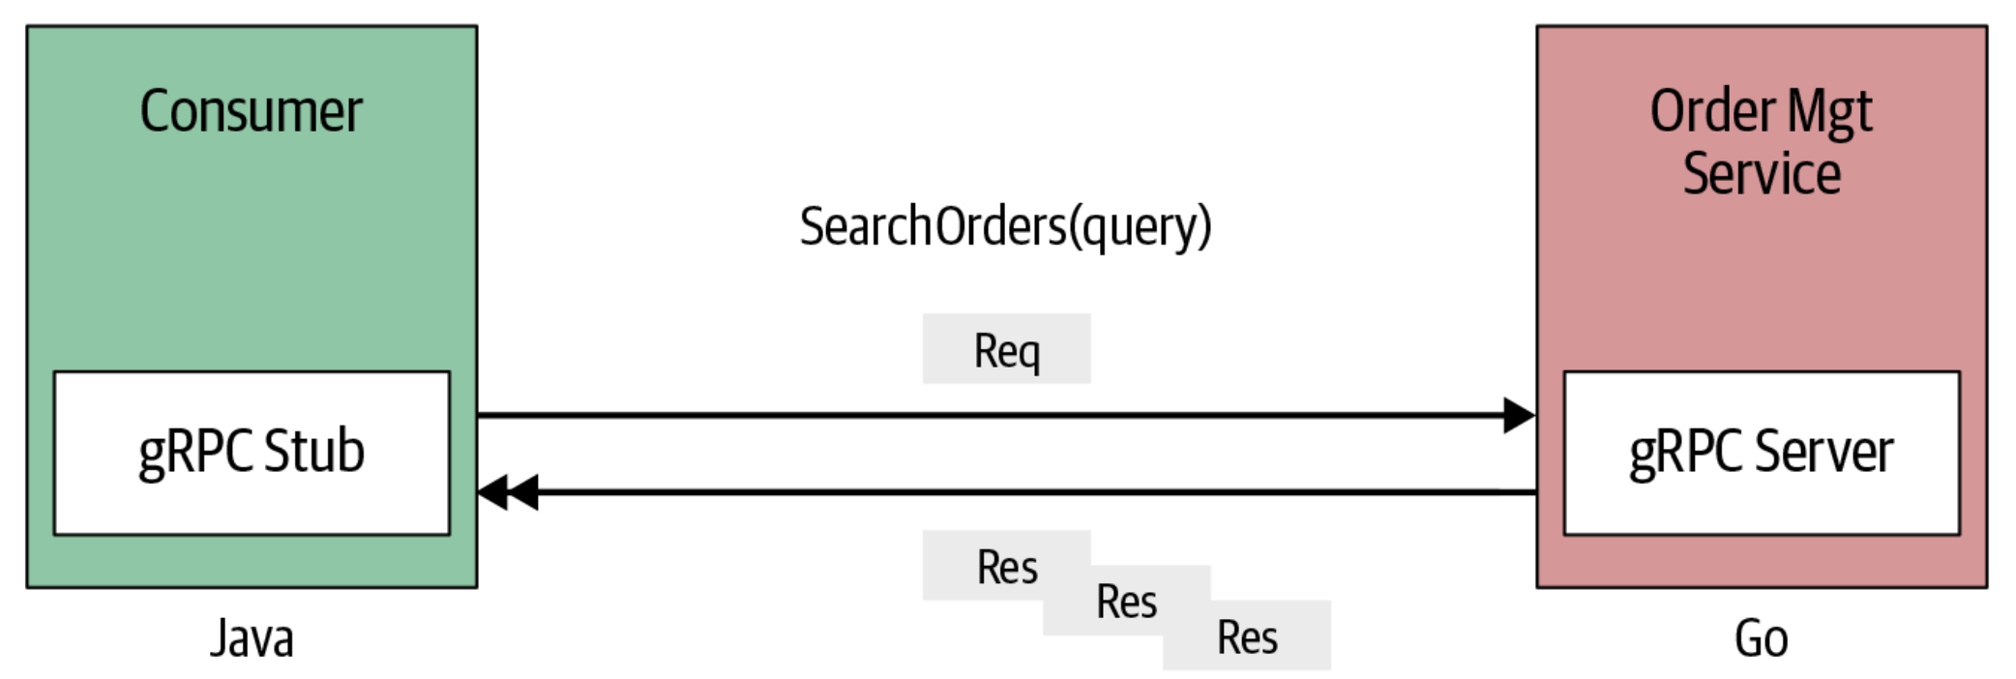
Server-side Streaming

Slide 24
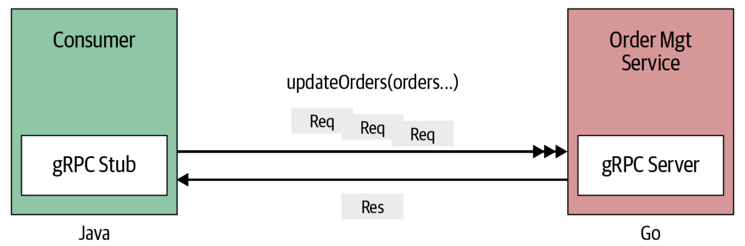
Client-side Streaming

Slide 25
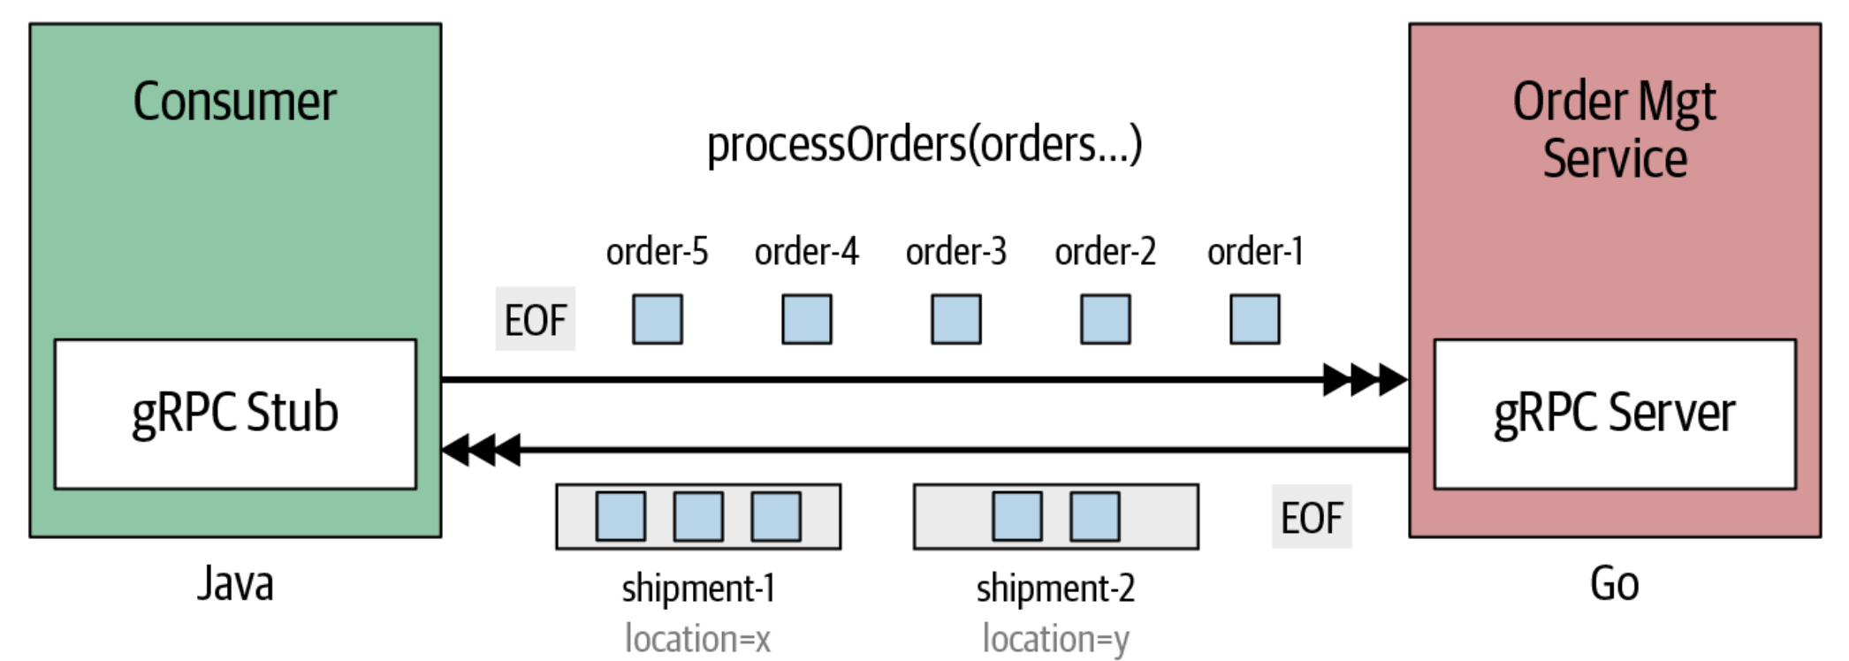
Bidirectional Streaming

